Slide 1

G-Store Customer Revenue Analysis
Tresa Varghese

Slide 2
Objective
- Pareto principle : 80 – 20 rule
- 80% of the revenue is generated by 20% of customers
- Identifying these high revenue generating customers is crucial to any business.
- Develop focused marketing strategies

Slide 3
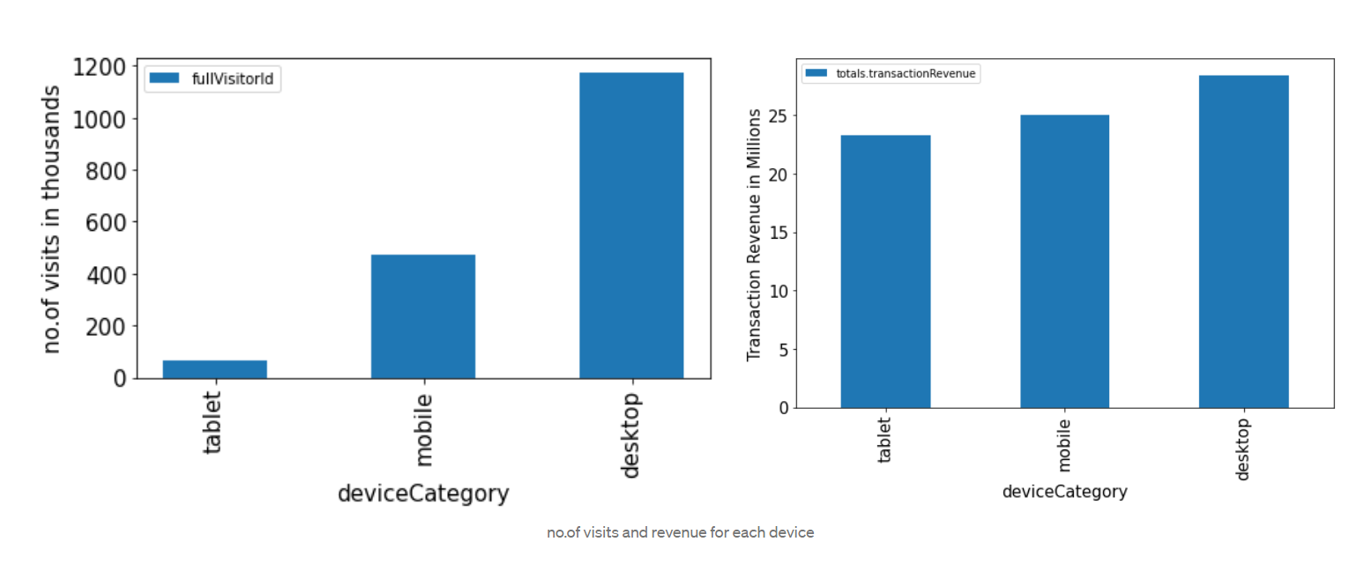
Device category analysis

Slide 4
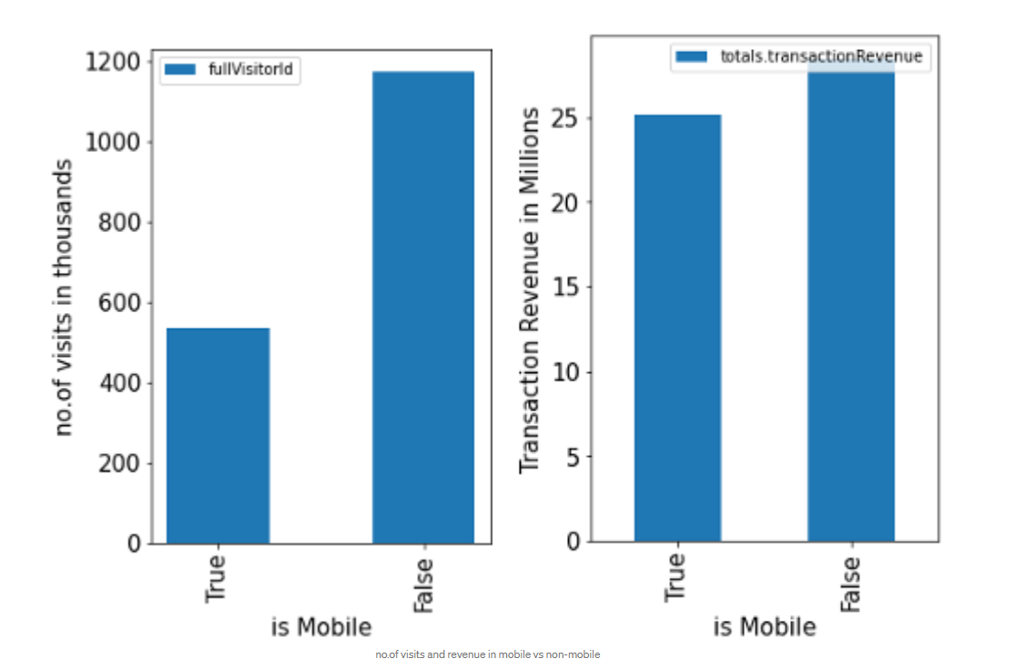
Mobile vs non mobile device

Slide 5
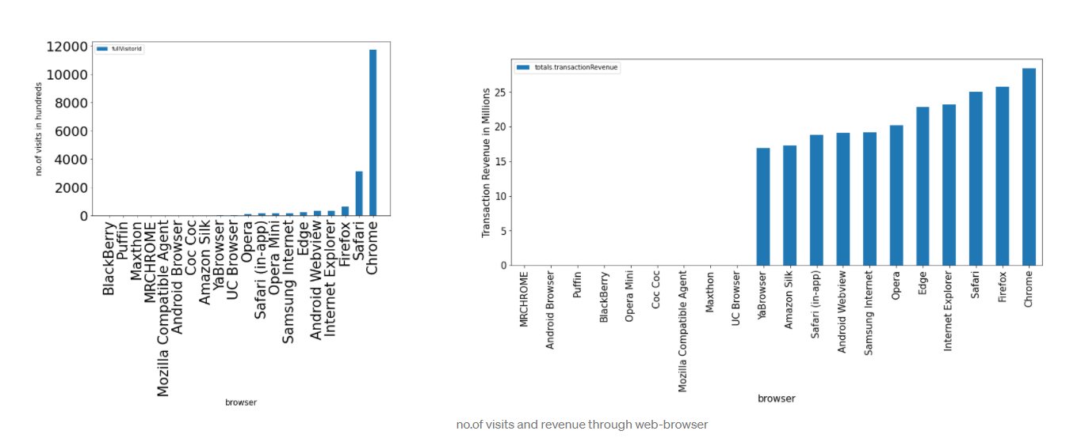
Browser analysis

Slide 6
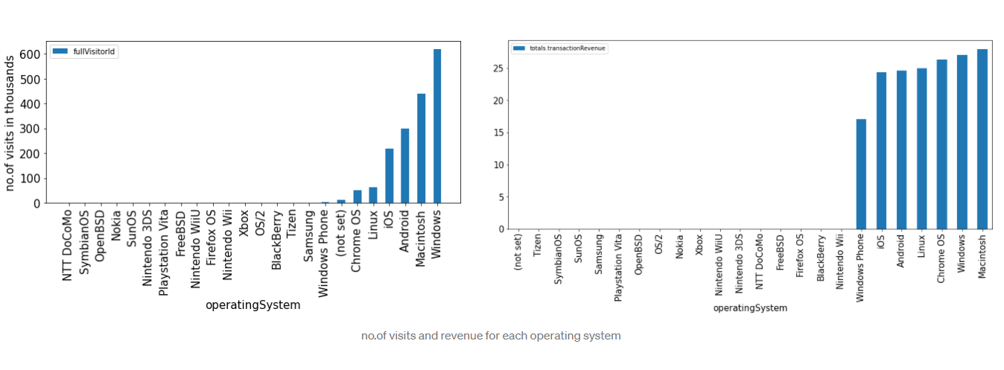
OS analysis

Slide 7
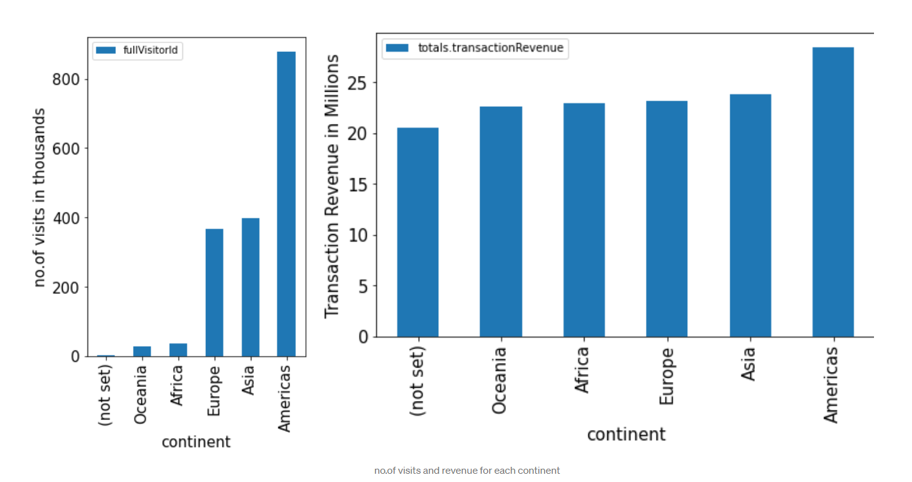
Geographic distribution

Slide 8
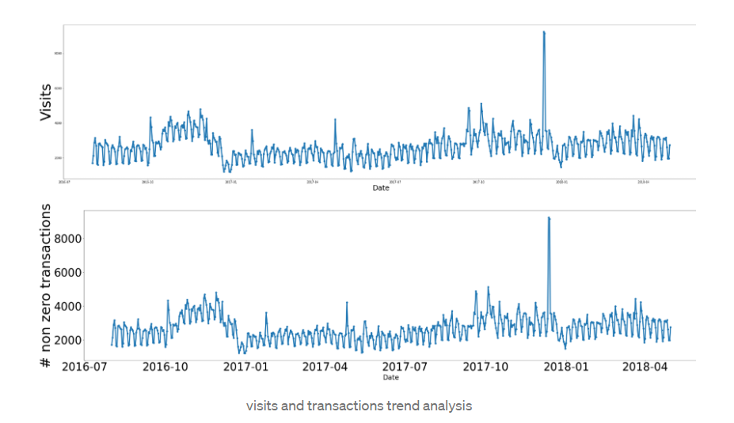
Seasonality analysis
Peak season

Slide 9
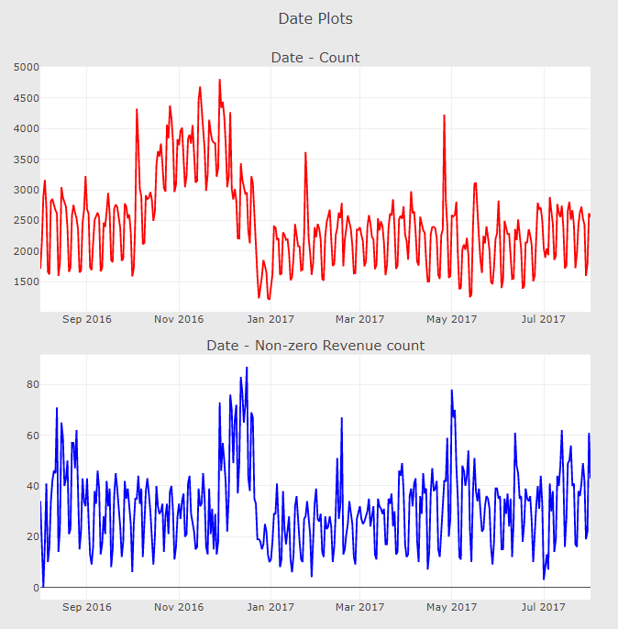
Drill down into peak season

Slide 10
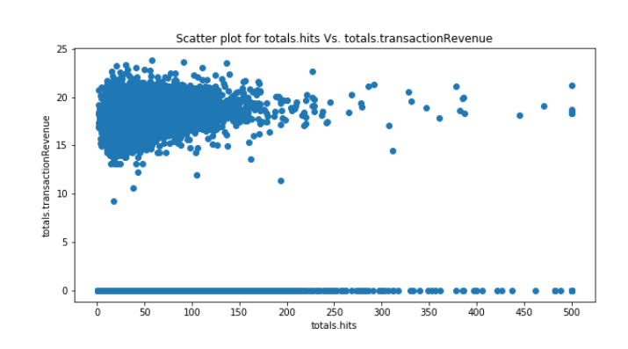
Number of hits vs revenue

Slide 11
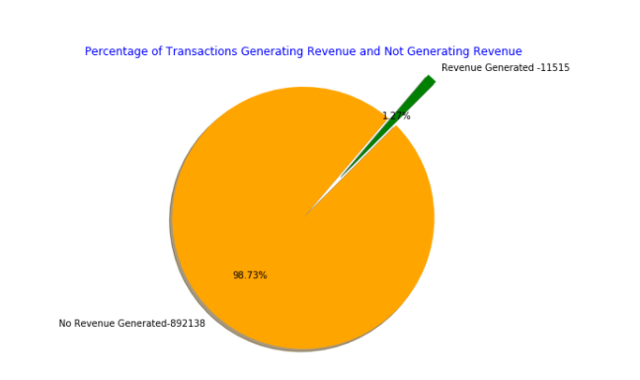
Comparison of transactions

Slide 12
Findings
* Need to develop focused marketing strategies for increasing customer base in Oceania and Africa
* Most revenue generating groups identified are Non-Mobile users and desktop customers, Windows and Mac users
* Though all continents generates fairly good revenue, Americas generates the most.
* Need to focus on increasing revenue generating transactions and handle peak seasons.

